Slide 1

Smart Parking System
IoT Bootcamp
Team 5

Slide 2
Problem Statement
With growing popularity of Smart Cities, there is always a demand for smart solutions for every domain. There are multiple domains in smart cities and smart parking system is one of them.
We intend to develop a smart parking system using IoT that allows for efficient parking space utilization and use IR sensors for sensing parking slot occupancy along with a dc motor to simulate as gate opener.
We will send data to webserver for looking up the availability of space for vehicle parking. Here we are using firebase as IoT database to get the parking availability data.

Slide 3
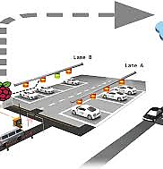
Problem Statement (cotd.)
Users can check for available parking spaces online from anywhere using a smartphone.
Thus the system solves the parking issue for cities and users get an efficient parking management system.

Slide 4
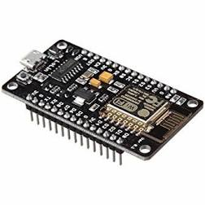
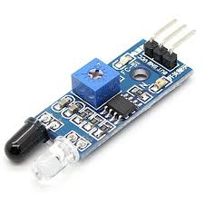
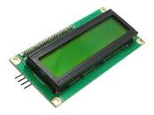
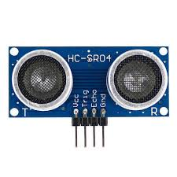
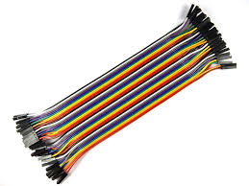
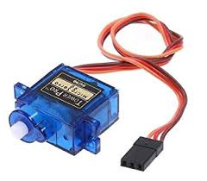
Hardware Used
ESP8266 NodeMCU LCD Screen IR Sensor
Ultrasonic Sensor Jumpers
Servo Motor

Slide 5
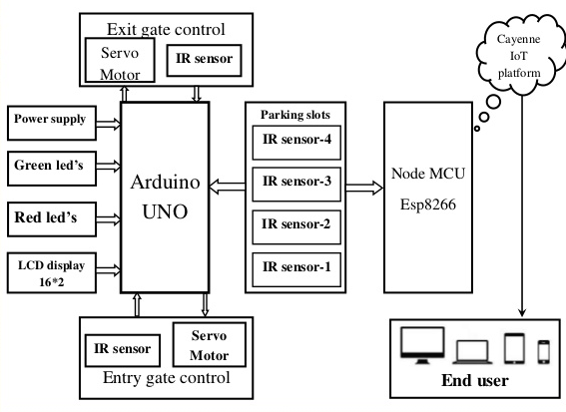
Circuit Diagram
FireBase
Ultrasonic sensor -4
Node
MCU
Esp8266
Ultrasonic sensor -3
Ultrasonic sensor -2
Ultrasonic sensor -1

Slide 6
Proposed System
The proposed system consists of the following phases:
Development of Android app
Free Space Identification
Visualization in Server for Owner to Analyze

Slide 7
Implementation
Development of Parking App
The mobile app is developed using MIT App Inventor. Application modules are Registration, Login, selecting date and timing or how many days, Parking slot selection, Price calculation and payment.

Slide 8
Implementation (cotd.)
2. Free Space Identification
Free slot identification is verified using IR sensors. IR sensors are used for each parking slot. The sensors detect the vehicle. A pulse of IR light is generated by the IR sensor and emitted by emitter. Ultrasonic sensors are also used which estimate the distance of the vehicle from parking slots. Detected information will be sent via WI-FI module to transfer the information to FireBase cloud and results are displayed on LED screen.

Slide 9
Implementation (cotd.)
3. Visualisation
Owner of the parking center can visualize time to time slot availability periodically. Webpage is created using PHP and parking information. At the back end, FireBase database is used to store the information on a cloud. The web page contains local host and global host connectivity.

Slide 10
Challenges Faced
We faced difficulties in accessing data from firebase into the android app.

Slide 11
Limitations
Mechanical fault in servo motor acting as gate opener which allows more than one vehicle to pass at a time.
Lack of computational capability when handling lot of data

Slide 12
Future Scope
A website can developed which will help users visualise the status and availability of parking slots from anywhere at any time.
Raspberry pi can be used which gives more computational power capabilities.
The model can be extended for multi storage parking space.
The android app can be developed to incorporate more advanced features.

Slide 13
Budget Estimate
Smart Parking System is a low budget solution to parking problem in cities.
Mobile app allows the user to locate and reserve a parking slot in online, navigation from entrance gate to available parking slot is also the proposed system reduces the drivers effort and time to search parking space.
Our project thus aims to solve the problem efficiently.

Slide 14
THANK YOU
Dhwaj, Priyansh, Ayush, Moksha, Sindhu, Ummul

